Slide 1
GDP Assignment Analysis
V V SATYA SAI KIRAN KUSUMANCHI

Slide 2
Project analysis slide 4
GDP Analysis
Understand top and last perfoGDP_asgrmers of states w.r.t GSDP
To understand the GDP of different states so that CMs can get guidance on how to improve the same.
Part 1-A
Objective1
Segmentation of states according per capita GSDP to understand the contribution of working sectors
Data Source
Implementation Plan
Part 1-B
To understand how school drop rate is affecting the GDP of a state
GSDP data of individual sources form here
Sector contribution to GSDP here
Drop out rate from here
GDP_asg.ipynb attached in the zip file
Objective 2
To understand the relation between the school drop out rate with the GSDP
Part - 2

Slide 3
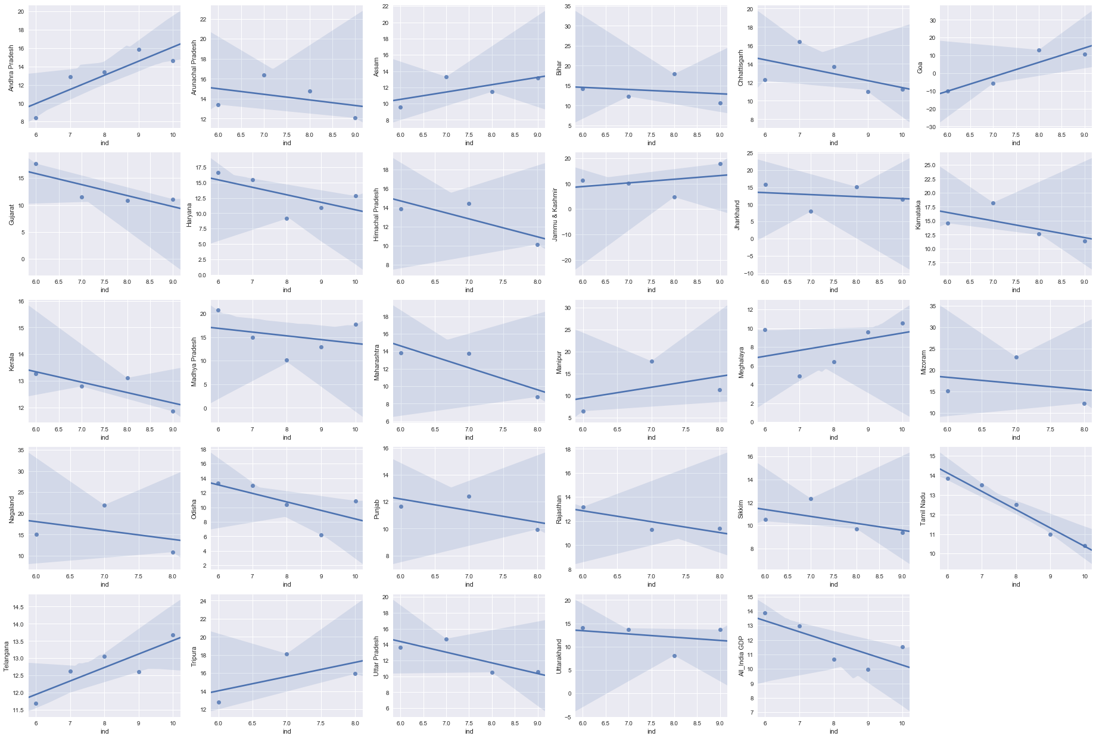
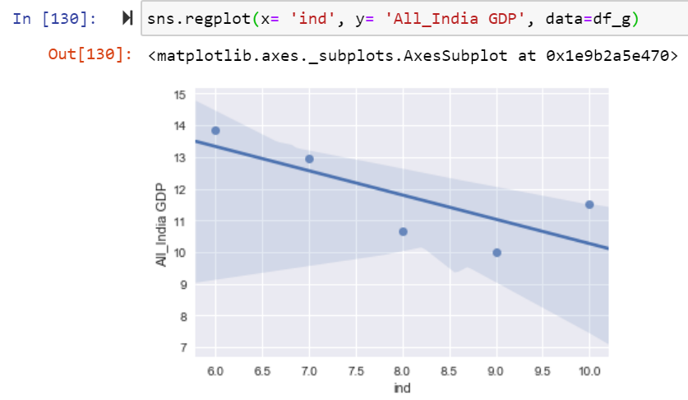
Project analysis slide 5
Part 1-A Analysis
%Growth of GSDP over 4/5 year for all states and India(last fig)
My home state is Andhra Pradesh, will take the mean of Andhra Pradesh which is 12.036 and mean of India which is 11.79 with this info we can say that comparative to the home state and the country the Andhra Pradesh growth rate is 1.23 more that that of the Nation.
India GDP % growth over 4 years

Slide 4
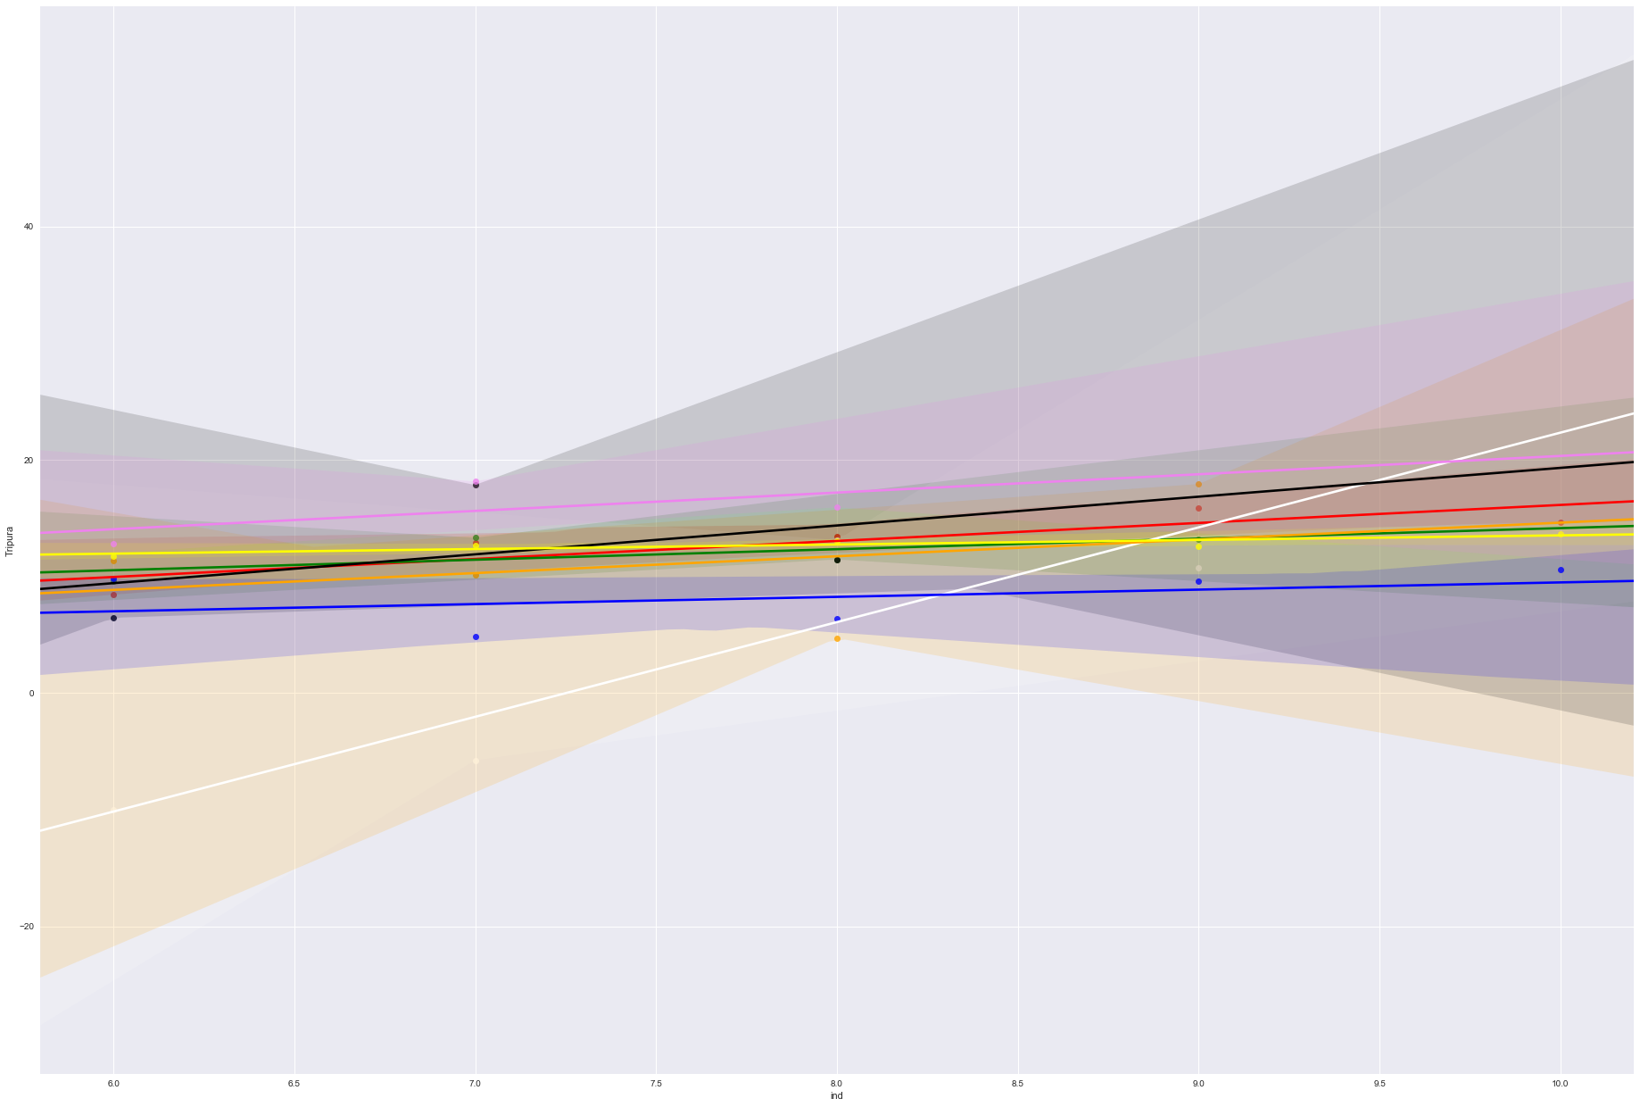
Project analysis slide 5
Part 1-A Analysis
3Fast and Consistently growing states
Goa(white line)
Tripura(Pink)
Manipur(Black)
Struggling states with Growth
Haryana
Odisha
Tamil Nadu

Slide 5
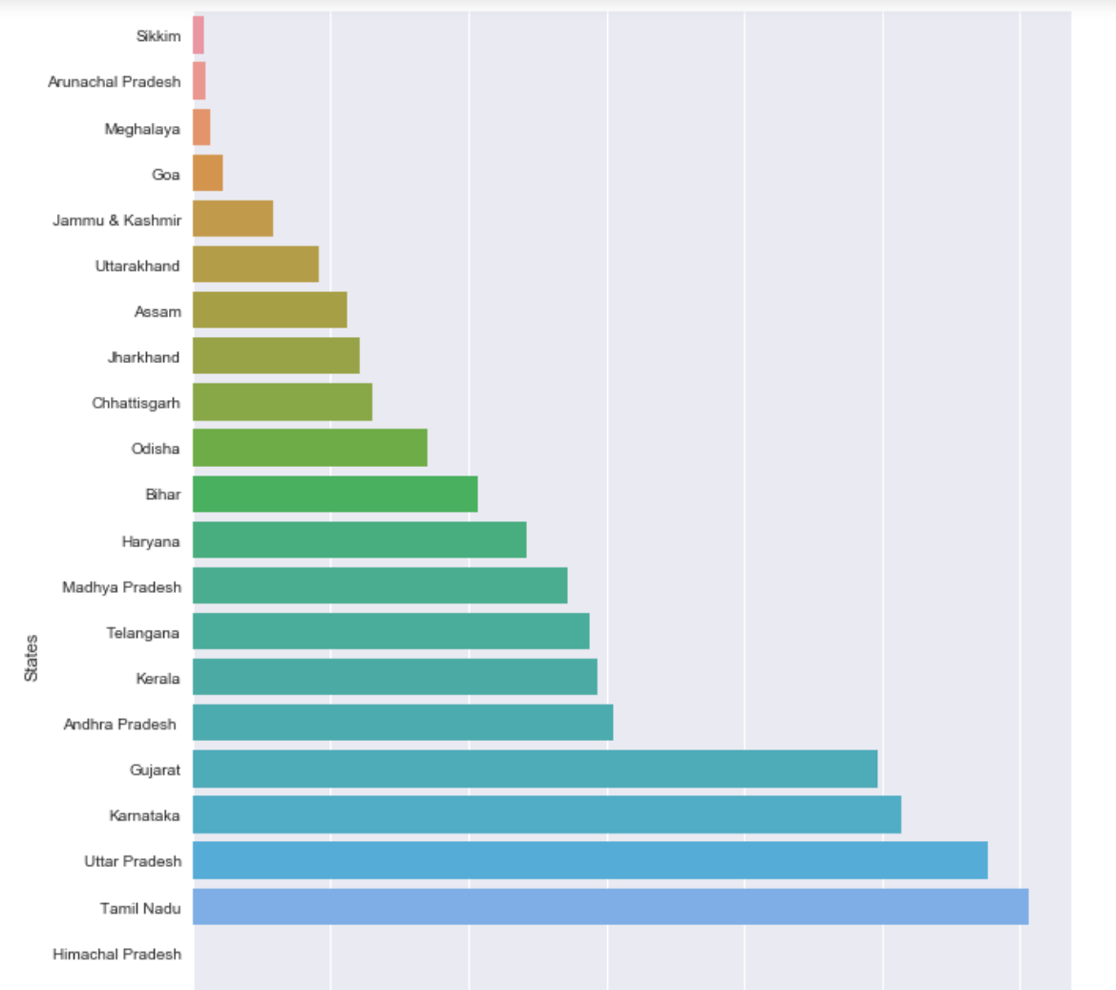
Project analysis slide 5
Part 1-A Analysis
GDP of the states for the year 2015-16
Approach: Horizontal bar graph for this because :
this is a One Fiscal Year GDP and it would be easier to compare if its horizontal as we have a greater number of states. I have sorted the values so that we can quickly take away the names of states having highest and lowest GDP
Identify the top 5 and the bottom 5 states based on total GDP.
Top 5:
Tamil Nadu
Uttar Pradesh
Karnataka
Gujarat
Andhra Pradesh
Bottom 5:
Sikkim(Bottom /Least)
Arunachal Pradesh
Meghalaya
Goa
Jammu & Kashmir

Slide 6
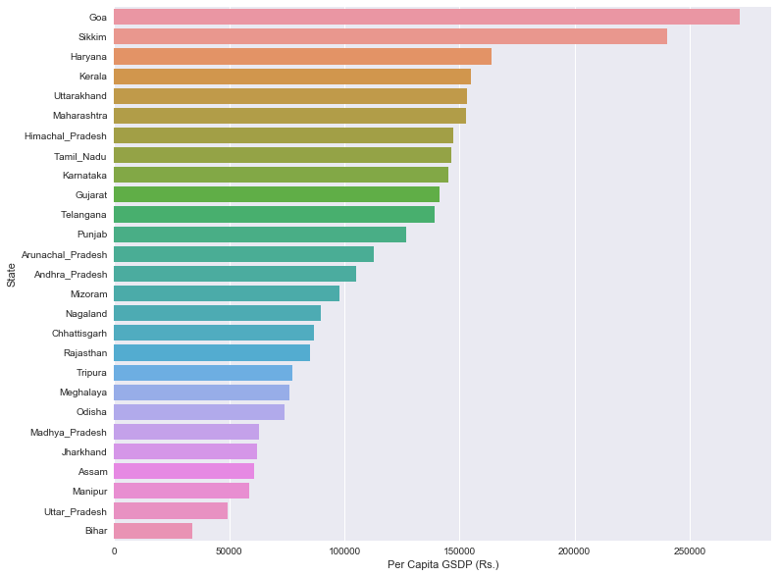
Project analysis slide 5
Part 1-B Analysis
Plot illustrating the highest to lowest per capita GSDP of all states(2014-15)
Approach: Horizontal bar graph for this because :
this is a One Fiscal Year GDP and it would be easier to compare if its horizontal as we have a greater number of states. I have sorted the values so that we can quickly take away the names of states having highest and lowest per capita GDP
Ratio of the highest per capita GDP to the lowest per capita GDP: 800%
Identify the top 5 and the bottom 5 states based on the GDP per capita.
The top 5 states:
Goa
Sikkim
Haryana
Kerala
Uttarakhand
Bottom 5 states are:
Jharkhand
Assam
Manipur
Uttar_Pradesh
Bihar(Lowest GSDP)

Slide 7
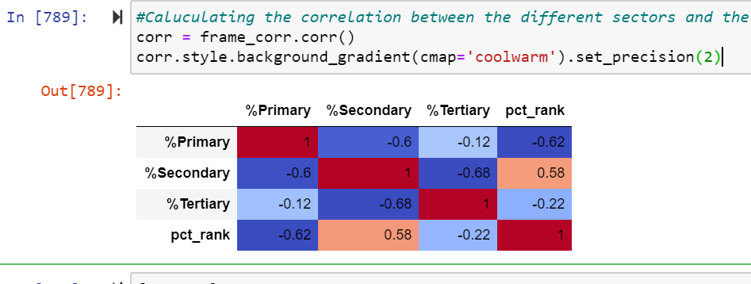
Project analysis slide 5
Part 1-B Analysis
Observations:
Why is (Primary + Secondary + Tertiary) not equal to total GDP?
If we observe in the above result. %TotalSec (i.e Primary + Secondary + Tertiary) + %Taxes -%Subsidies = 100% As the there are taxes being collected and also part of the income to the nation, so just the sectors contribution won’t be the total GDP
Can you draw any insight from this? Find correlation of percentile of the state (% of states with lower per capita GDP) and %contribution of Primary sector to total GDP.
As we can see the correlation between the Primary sector % vs the Percentile rank we can see that the Percentile rank of the Per Capita GDP of the state is highly negatively correlated with the Primary sector i.e in simple terms if the primary sector contribution is more then we can see the percentile of the states per capita GDP is less.

Slide 8
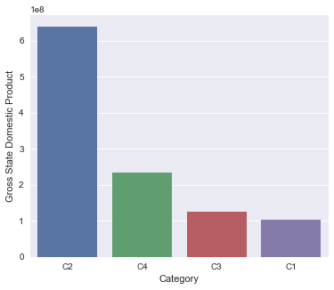
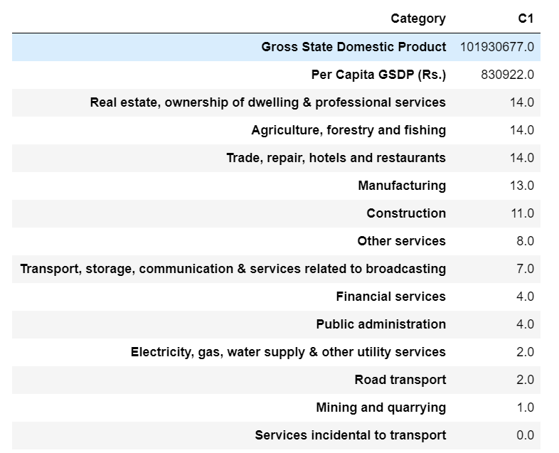
Project analysis slide 5
Part 1-B Analysis
Plot illustrating the GSDP vs categories
Table illustrating the Sub- sectors contribution(%)to the C1 category

Slide 9
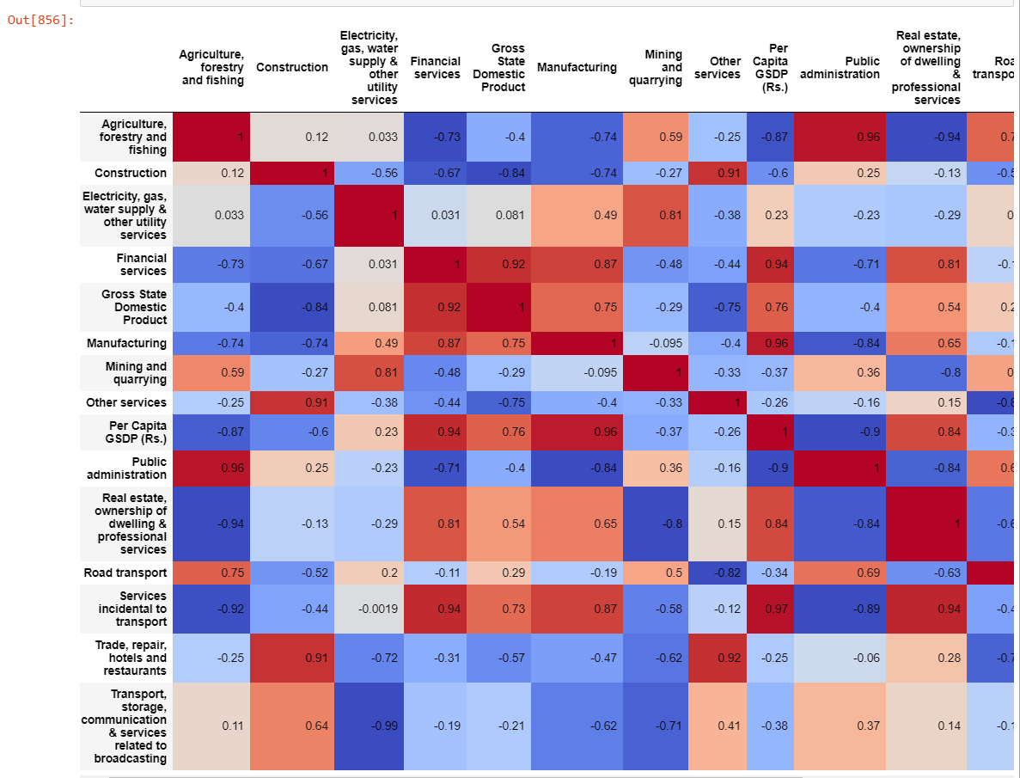
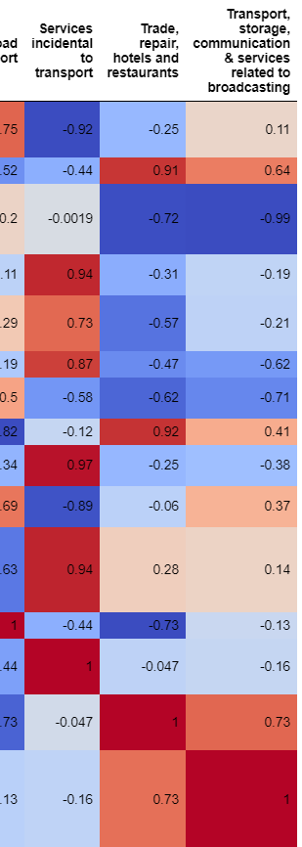
Project analysis slide 5
Part 1-B Analysis
Correlation Graph for the subs sectors to the GDP(2014-15)
Which sub-sectors seem to be correlated with high GDP?
GSDP is highly correlated with Financial Services and Manufacturing positively. So we can understand that the GSDP increases with more investment going into both of these sectors. Else to diversify the investment by the state government, they also can invest in the industries related to the Construction.
Which sub-sectors do the various categories need to focus on?
If we see the sort of the GSDP and how the categories are based on the Per capita GSDP. We can say that the role of the Services Industries(Financial, Manufacturing and Real estate and its dependent escorts) would help any Category to boost the GSDP there by helping the States to improve the Per capita GSDP.

Slide 10
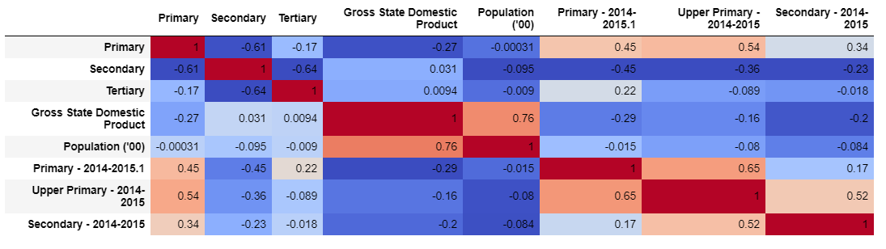
Project analysis slide 5
Part 2 Analysis
correlation between the Sectors of Work Vs. Education level dropouts(%)

Slide 11
Project analysis slide 5
Part 2 Analysis
Is there any correlation between dropout rate and %contribution of each sector (Primary, Secondary and Tertiary) to the total GDP?
Primary Sector:
If there is significant contribution from Primary sector, we can see that Primary School dropout is increasing.
Observations:
It can be understood that the children who are getting dropped out of the primary, upper primary, Secondary could have been possibly been working in the Primary sector as the correlation is positive and we can understand with this that in order to get the GSDP increased and Per capita GSDP increased government needs to make sure that the child labor is not allowed in the un organized sectors like most of the sub sectors in Primary.
For the same Government also need make sure that they are closely monitoring the drop out rates in Primary and Upper Primary because it is also seen that there is decline in the correlation between Primary sector and Secondary drop out so we can understand that if the child is completing the primary and Upper Primary chances are high the child would continue Secondary
Secondary Sector:
Observations:
It is clearly seen in the correlation map that the Secondary sector is showing negative correlation with the Primary, Upper Primary and Secondary dropouts.
It means when there is reasonable amount of children dropping out at the initial schooling level it can be understood that the same child can have challenges in getting job/ income sources in the secondary and above sectors.

Slide 12
Project analysis slide 5
Part 2 Analysis
Is there any correlation between dropout rate and %contribution of each sector (Primary, Secondary and Tertiary) to the total GDP?
Effect on Tertiary Sector
Observations:
A. As we can see in the correlation matrix with the Increase in the drop out rates of upper primary and secondary the Tertiary sector contribution is getting reduces. As mostly the tertiary sector consists of the ecosystem like Financial services/Public administration which demands higher education qualification mostly.
B. To ensure that government is focusing the increase of GSDP from Tertiary contribution the root cause where it needs to be fixed is to reduce the school drop out rates and provide them necessary infrastructure so that they get required educational qualification there by increasing the percentage of the tertiary sector contribution
You have the total population of each state from the data in part I. Is there any correlation between dropout rates and population? What is the expected trend and what is the observation?
Observations:
A. With the increase in the population we can observe that the drop out rate in the Secondary schooling is getting increased in relative to primary and upper primary, may this can be understood that not so highly economic privileged parents are not able to afford the Secondary education if they have more children.

Slide 13
Project analysis slide 5
Hypothesis
From all the analysis: We can see that the total GSDP is less for the states where the per capita GSDP is more(C1 category). with this we can say that the Primary sector where it has more contribution also requires lot of unorganized workforce which is in turn more and this is also influencing to reduce the per capita GSDP.
If we want to increase the Per capita GSDP and get the state into path of development curve we need to make sure that the government incentivizes the investors of Secondary and mainly tertiary such as Finance and Services oriented eco system.
We can also see that when ever the population is getting increased the drop rate of the children at the earlier stages of the education is also getting increased. There should be awareness among the workforce of the Primary sector to make their children to continue with their education. When there is improvement in the education levels of the children we can say that the particular state has the population which is Tertiary/ Secondary(at least) ready and then we can see that the Percentage contribution of the Tertiary sectors getting increased which keeps the state in the path of developments as the values of the tertiary gets increased in long term.

Slide 14
Thank You

